Slide 1
JSP Tag Libraries Tag Libraries JSTL #JSTL

Slide 2
Review
JSP Standard Actions
jsp:method attribute
Java Beans
jsp:useBean, jsp:setPropety, jsp:getProperty
Scopes: page, request, session, application
Dispatching Mechanisms
jsp:include, jsp:forward, jsp:param
Expression Language – EL
${EL Expression}
Operators, Implicit Objects, Scope Variables
Functions
Coersions

Slide 3
Objectives
How to remove all java code in JSP (View)? Complete the MVC 2 Design Pattern with View
JSTL
How to build the data grid tag library using in JSP?
Tag Libraries
Model
Classical, Simple, and Handles
How to implement the custom Tag Lib and use it in JSP

Slide 4
JSTL JSP Standard Tag Library
Is a new component being offered by the Sun for JSP programming.
A library of predefined tags (by Sun) that provides a set of reusable standard tags that works in the similar manner everywhere
Allows programming using tags rather than scriptlet code JSTL has reusable standard set of tags.
Provides the user with a script-free environment
Are easier for non-programmers & inexperienced programmers
Disadvantages
It adds processing overhead to the server. The tag libraries are compiled into a servlet, which is then executed by the servlet container. The server is added with much more code by the JSTL.
JSTL is also less powerful than the scriptlets as embedded java codes can do everything in JSP pages

Slide 5
JSTL Type of Tag Library
JSP Standard Tag Library (JSTL)
Core Tag Library
EL Functions
SQL Tag Library
I18N & Formatting Tag Library
XML Tag Library

Slide 6
JSTL Core Tag Library
The library contains the tags for looping, expression evaluation, handle flow controls, and basic input and output.
It can be declared by
<%@ taglib prefix=“c” uri= “http://java.sun.com/jsp/jstl/core” %>
General Purpose Tags
Are used to set, remove and display variable values that are created within a JSP page.
The core tag library contains tags for getting, setting and displaying attribute values.

Slide 7
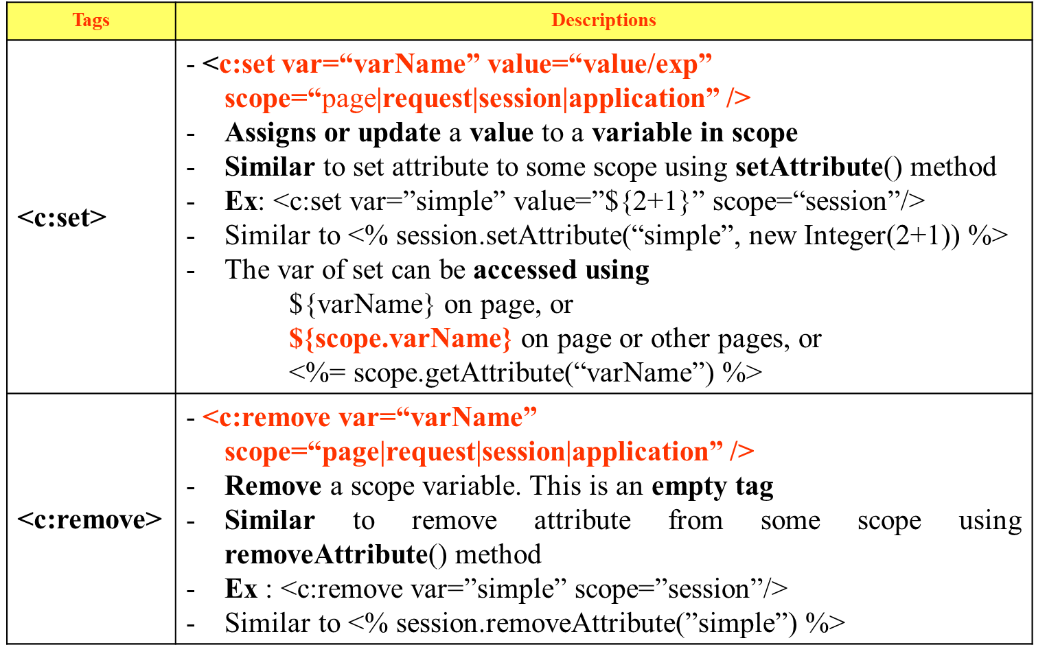
JSTL Core Tag Library – General Purposes

Slide 8
JSTL Core Tag Library – General Purposes
Tags | Descriptions
<c:out> | - <c:out value=“value|expression” escapeXml=“true|false” default=“defaultValue” /> Evaluate an expression & store the result in the current JspWrite object Default value if the resulting value is null Similar to print out the data using out object in JSP Implicit Object Ex: <c:out value=”${simple}”/> similar to <%= pageContext.getAttribute(simple) %>
<c:catch> | - <c:catch [var=”varName”]>…</c:catch> - Provides an exception handling functionality, such as try-catch, inside JSP pages without using scriptlets

Slide 9
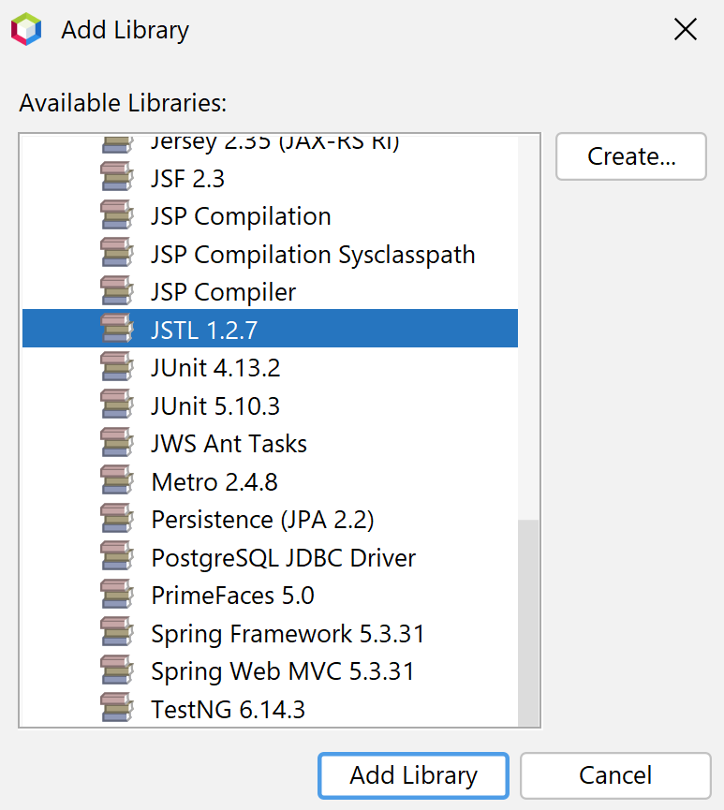
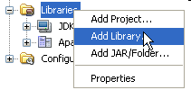
JSTL Requirement
Required Library for JSTL
JSTL 1.2.x

Slide 10
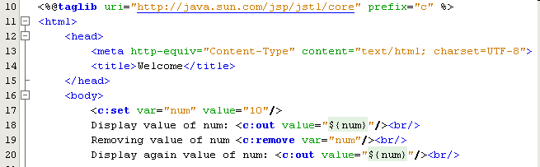
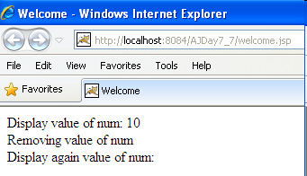
JSTL Core Tag Library – Example

Slide 11

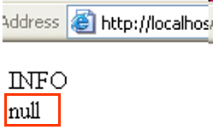
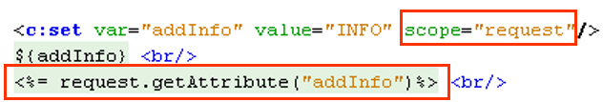
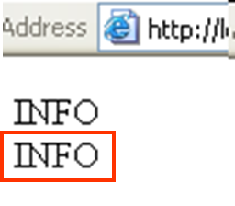
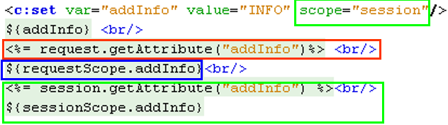

JSTL Core Tag Library – Example

Slide 12
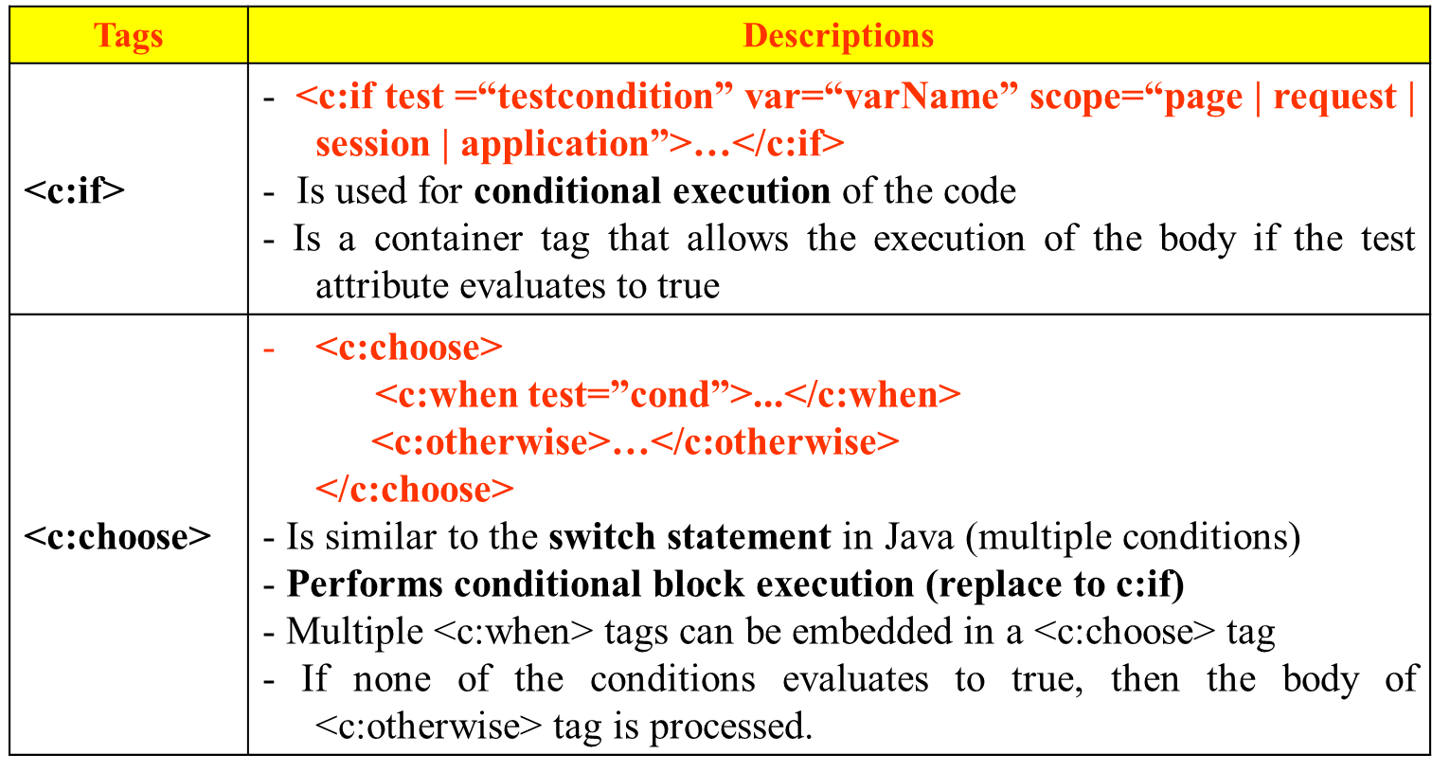
JSTL Core Tag Library – Decision Making
Support conditions in a JSP page
Are necessary as the contents or the output of the JSP page is often conditional based on the value of the dynamic application data

Slide 13
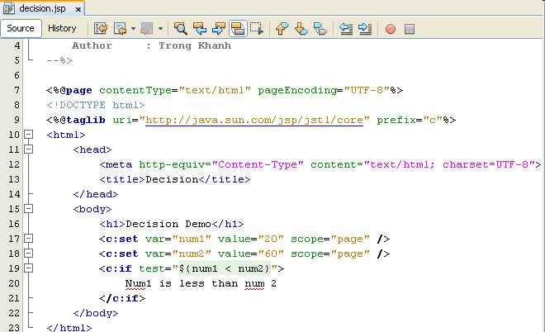

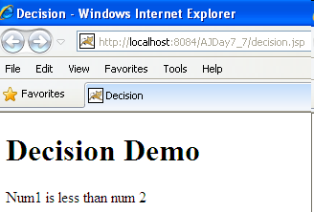
JSTL Core Tag Library – Example

Slide 14
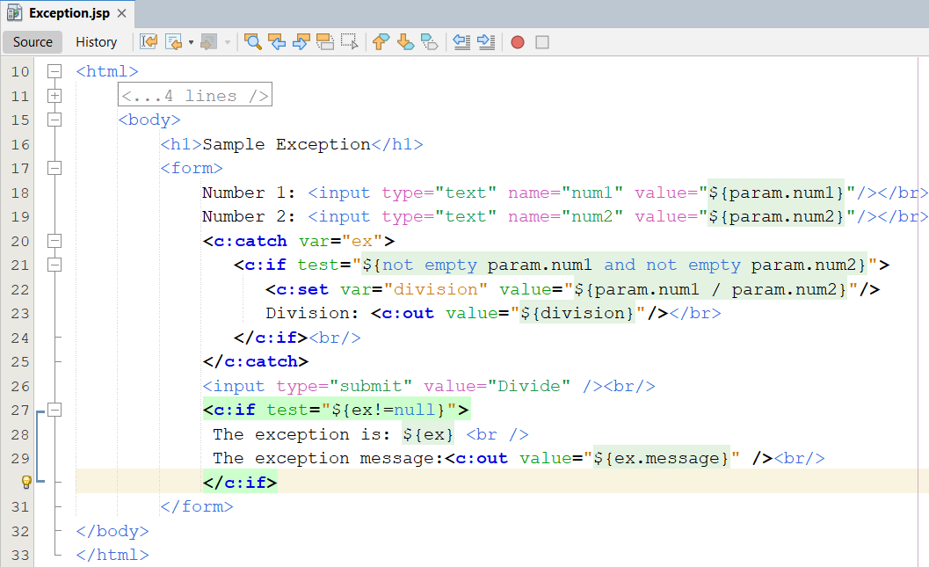
JSTL Core Tag Library – Example

Slide 15
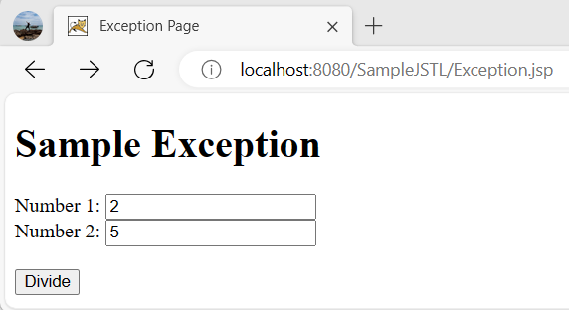
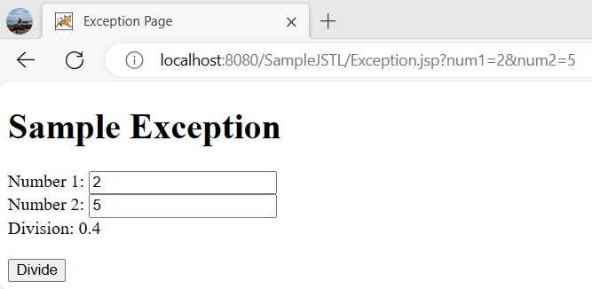
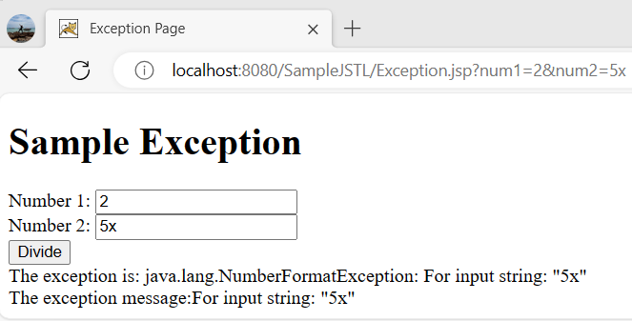
JSTL Core Tag Library – Example
111
121
131
Notes:
<%@ taglib prefix = "fmt" uri = "http://java.sun.com/jsp/jstl/fmt" %>
<fmt:formatNumber type="number" minFractionDigits="2"
maxFractionDigits="2"
value="${division}"/>

Slide 16
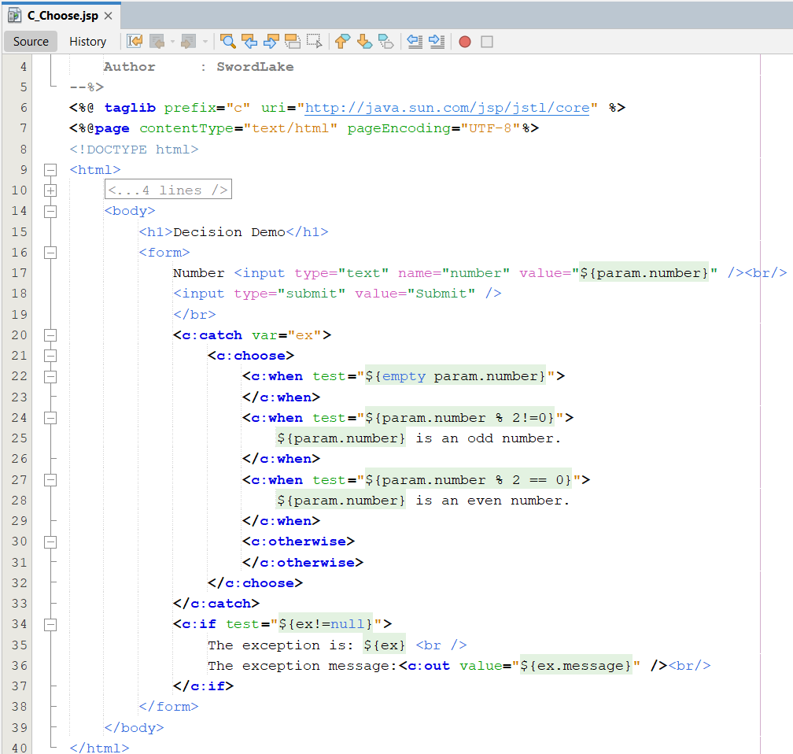
JSTL Core Tag Library – Example

Slide 17
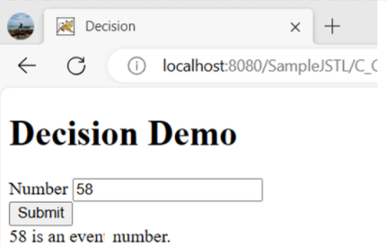
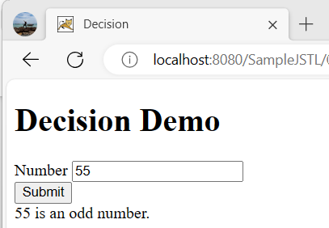
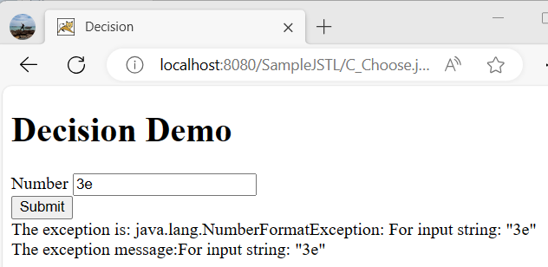
JSTL Core Tag Library – Example

Slide 18
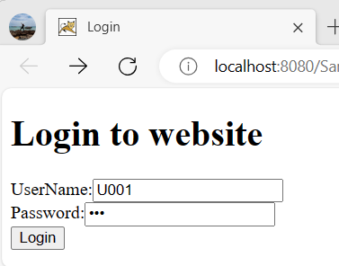
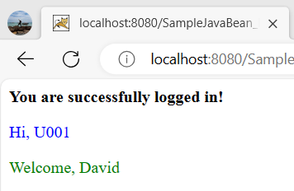
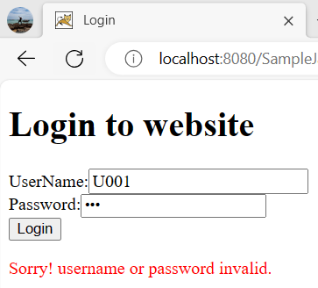
JSTL & EL Example

Slide 19
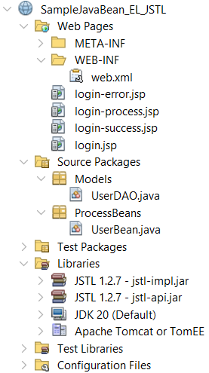
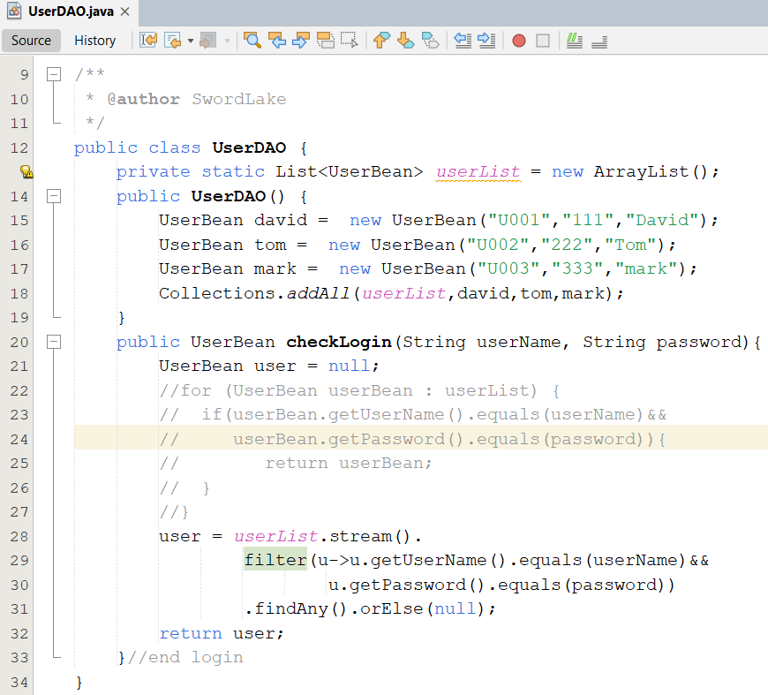
JSTL & EL Example
111

Slide 20
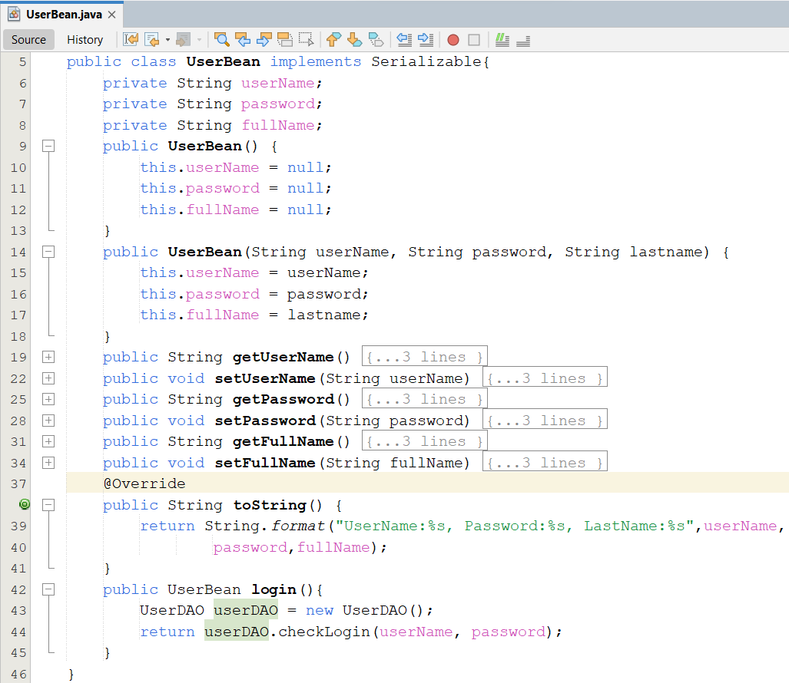
JSTL & EL Example
121

Slide 21
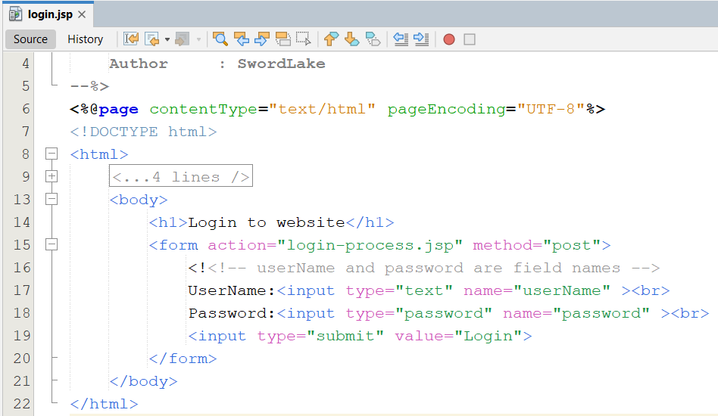
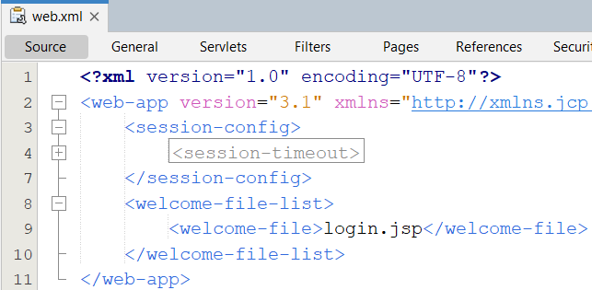
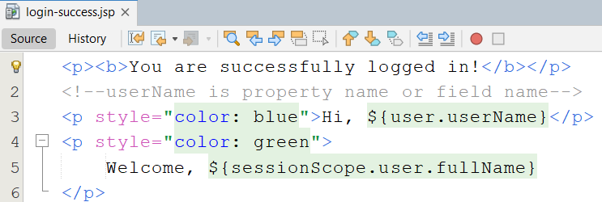
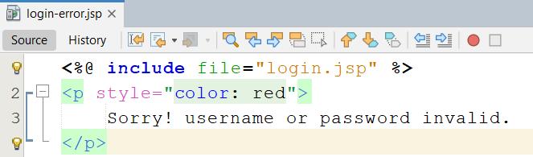
JSTL & EL Example
131
4
161
151

Slide 22
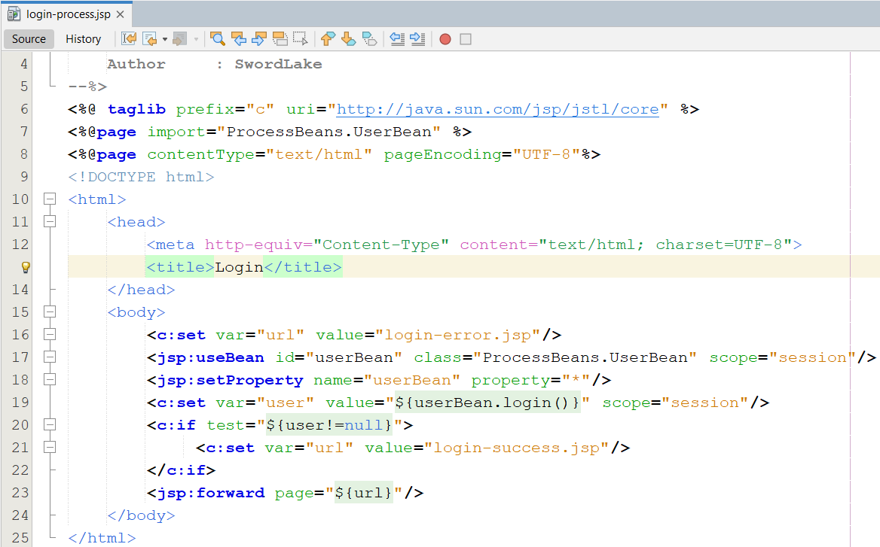
JSTL & EL Example
171

Slide 23
JSTL Core Tag Library – Iterations
Is required for performing looping function
The object can be retrieved from a collection in the JavaBeans component and assigned to a scripting variable by using iteration tags
Tags | Descriptions
<c:forEach> | - <c:forEach var=“varName” items=“collection” begin=“begin” end=“end” step=“step” varStatus=“internalLoopobject”>…</c:forEach> - Is used repeat the body content over a collection of objects Will continue for a number of times specified by the user in the code varStatus’s methods: count (int), current (obj), index (int)
<c:forTokens> | -<c:forTokens items=“stringofToken” delims=“delimiters” var=“varName” >...</c:forTokens> - Is used to iterate over a collection of tokens separated by user-specified delimiters - It is a container tag

Slide 24
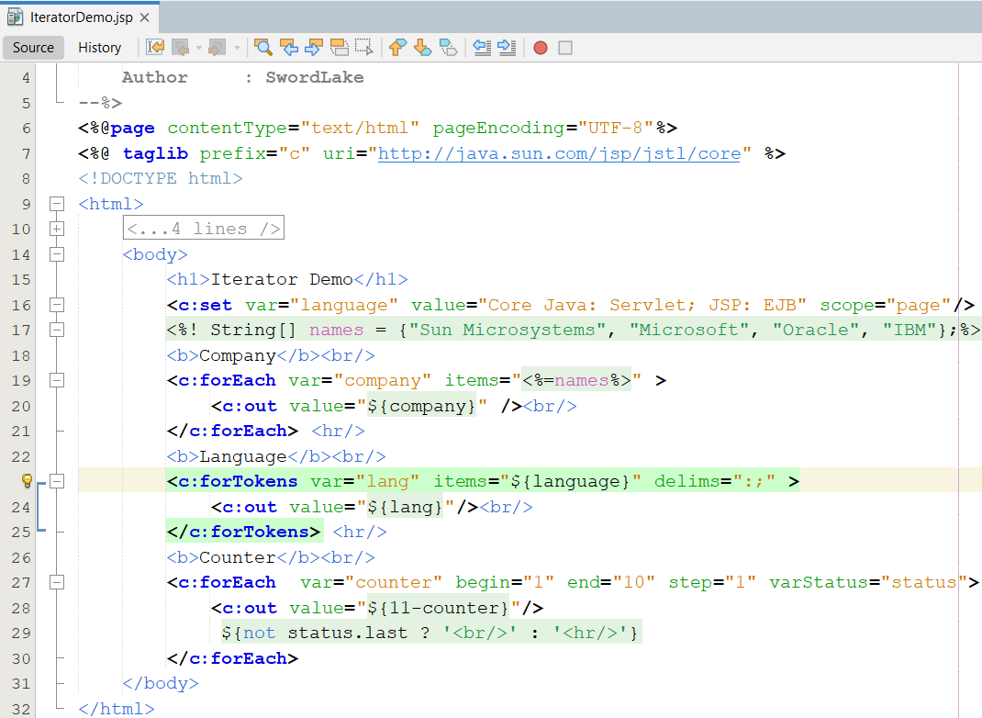
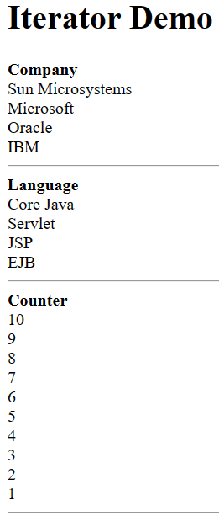
JSTL Core Tag Library – Example

Slide 25
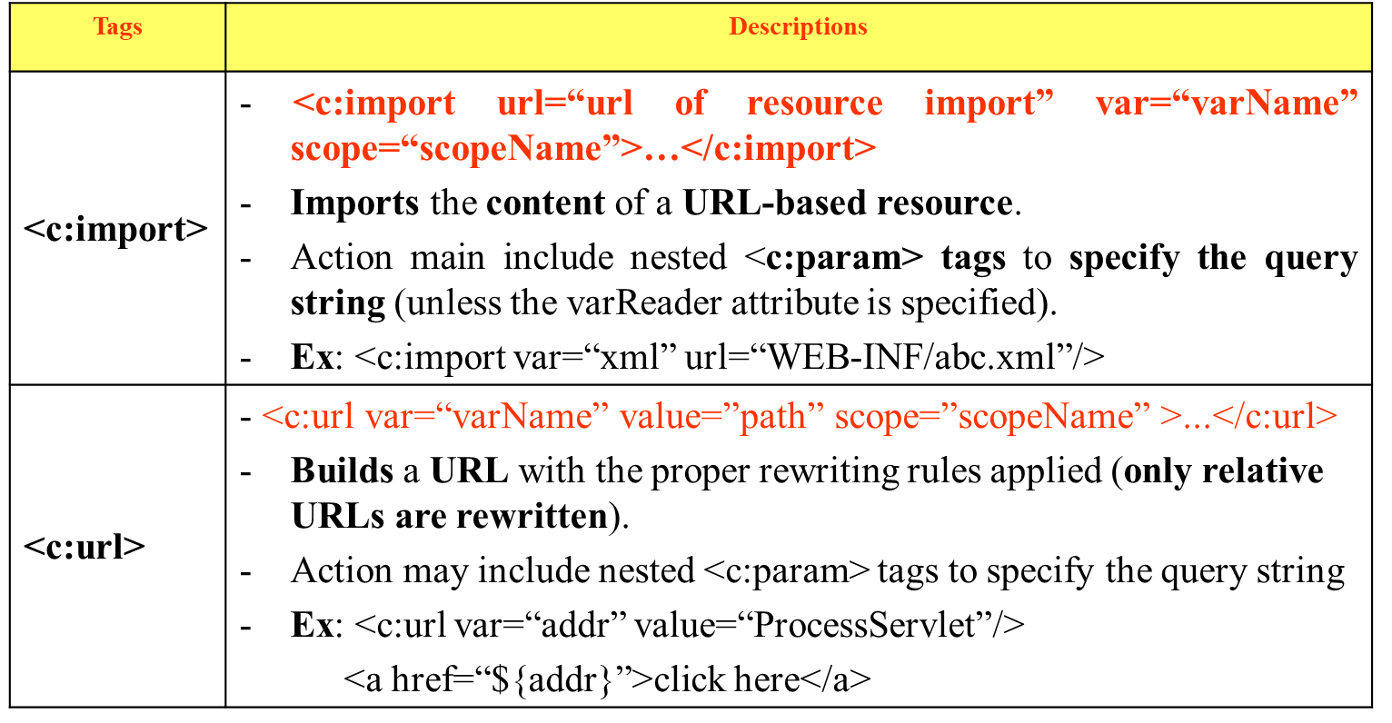
JSTL Core Tag Library – URL-Related Actions
Are used to import resources from a given URL, re-encode URLs, redirect to URLs, as well as pass additional request parameters where necessary

Slide 26
JSTL Core Tag Library – URL-Related Actions
Tags | Descriptions
<c:redirect> | <c:redirect url=“url path”>…</c:redirect> Sends the client a response to redirect to the specified URL. This action willabort processing of the current page. Action may include nested <c:param> tags to specify the query string. Ex: <c:redirect url=“abc.jsp”/>
<c:param> | <c:param name=“nameOfQuery” value=”ValueOfParameter”>...</c:param> Adds request parameters to a URL. This action can only be nested within <c:import>, <c:url>, or <c:redirect>

Slide 27
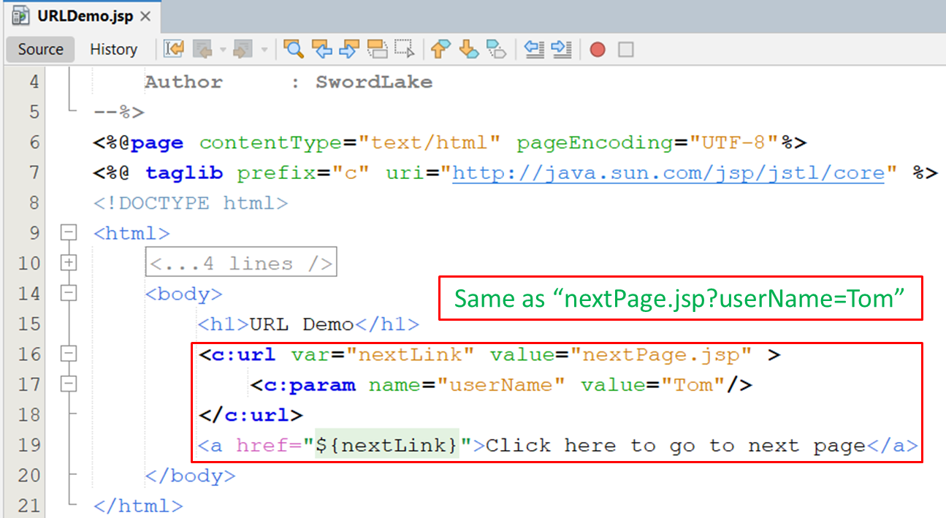
JSTL Core Tag Library – URL-Related Actions
111

Slide 28
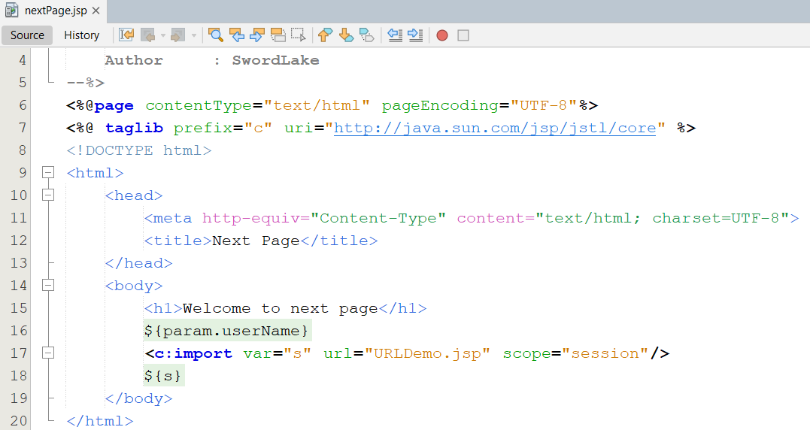
JSTL Core Tag Library – URL-Related Actions
2

Slide 29
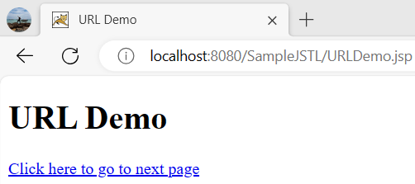
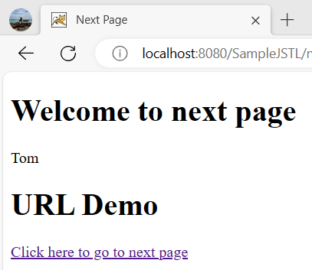
JSTL Core Tag Library – URL-Related Actions

Slide 30
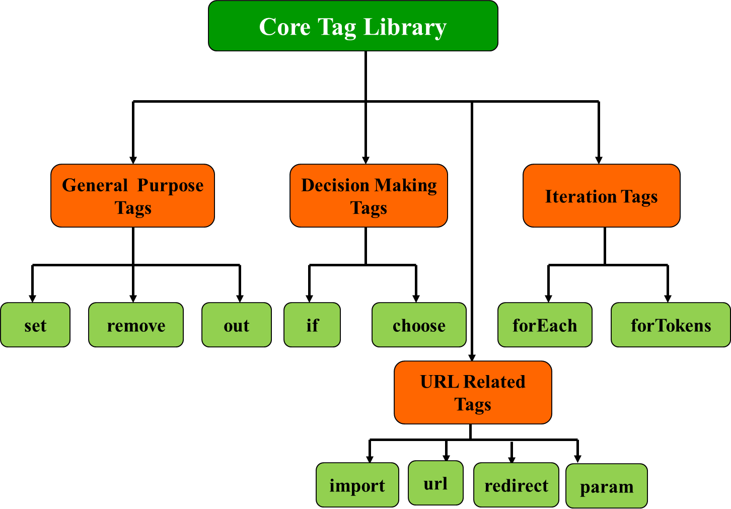
JSTL Core Tag Library – Summary

Slide 31
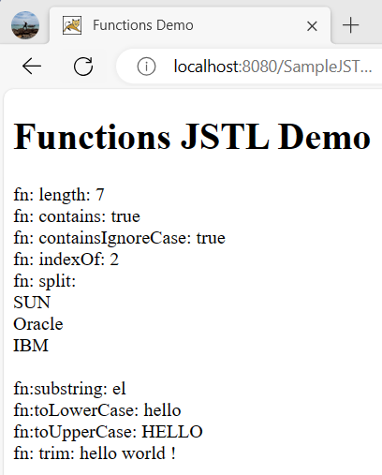
JSTL Functions Tag Libraries
The library contains tags, which provides the utility functions in process on jsp page combining jstl
All functions treat null Strings as empty Strings
It can be declared by
<%@ taglib prefix=“fn” uri=”http://java.sun.com/jsp/jstl/functions” %>
Some functions
fn:length
fn:contains
fn:containsIgnoreCase
fn:indexOf
fn:split
fn:trim
fn:substring
…

Slide 32
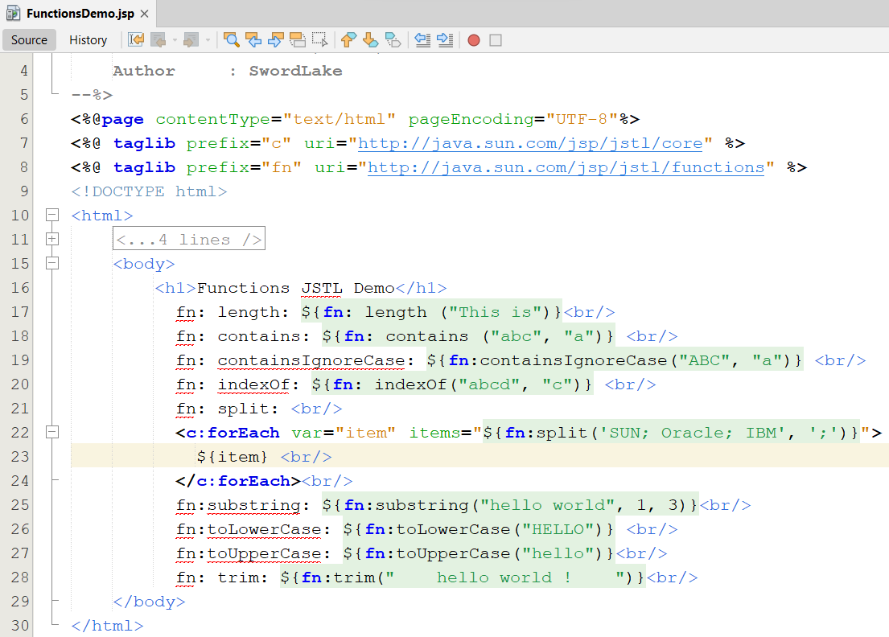
JSTL Functions Tag Libraries

Slide 33
JSTL SQL Tag Library
The library contains tags, which are used to access SQL databases, are used to perform the database related tasks, such as selection, insertion, deletion and modification without using java codes
It provides an interface for executing SQL queries on database through JSP.
It can be declared by
<%@ taglib prefix=“sql” uri=”http://java.sun.com/jsp/jstl/sql” %>
The “setDataSource” Tag
Is used to set a data source for the database.
Is an empty tag and allows the user to set data source information for the database
Syntax:
<sql:setDataSource dataSource=“datasource” | url=“jdbcurl” driver=“jdbcclassdriver” user=“username” password=“password” var=“varName” scope=“page | request | session | application” />
If the DataSource attribute is used, then url attribute cannot be used.

Slide 34
JSTL SQL Tag Library
The “query” Tag
Searches the database and returns a result set containing rows of data. (Passing database queries function)
The tag can either be an empty tag or a container tag.
The SELECT statement is used to select data from the table.
Syntax
<sql:query var=“varName” dataSource=“datasource” scope=“page | request | session | application”>
SQL Statement
<sql:param value=“value” />
</sql:query>
The “update” Tag
Executes the INSERT, UPDATE AND DELETE statements.
Zero is returned if no rows are affected by statements
Syntax
<sql:update var=“varName” dataSource=“datasource” scope=“page | request | session | application”>
SQL Statement
<sql:param value=“value” />
</sql:update>

Slide 35
JSTL SQL Tag Library
The var attribute of query Tag
Is javax.servlet.jsp.jstl.sql.Result interface
Methods
columnNames: Returns the names of the columns in the result
rowCount: Returns the number of rows in the cached ResultSet
rows: Returns the result of the query as an array of SortedMap objects
rowsByIndex: Returns the result of the query as an array of arrays
limitedByMaxRows: Returns true if the query was limited by a maximum row setting

Slide 36
JSTL SQL Tag Library
The “transaction” Tag
Is used to established a transaction context for <sql:query> and <sql:update> tags.
The connection object is obtained from <sql:transaction> as this tag is responsible for managing access to the database.
Syntax
<sql:transaction dataSource=“datasource” isolation=“isolationLevel”>
<sql:update> or <sql:query> Statements
</sql:transaction>
The “param” Tag
Is used to set values for parameters markers (“?”) in SQL statements.
It acts as a sub tag for <sql:query> and <sql:update>
Syntax
<sql:param value=”value”/>

Slide 37
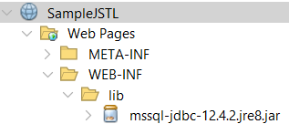
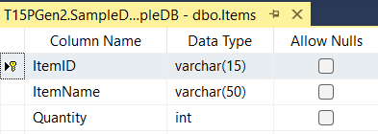
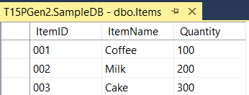
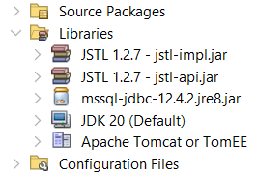
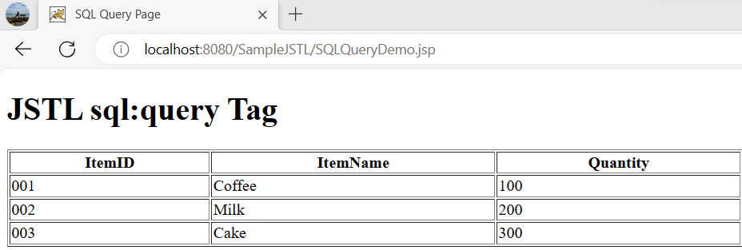
Build Library Tag Lib Library Requirements
Build the data grid by tag library as follows:

Slide 38
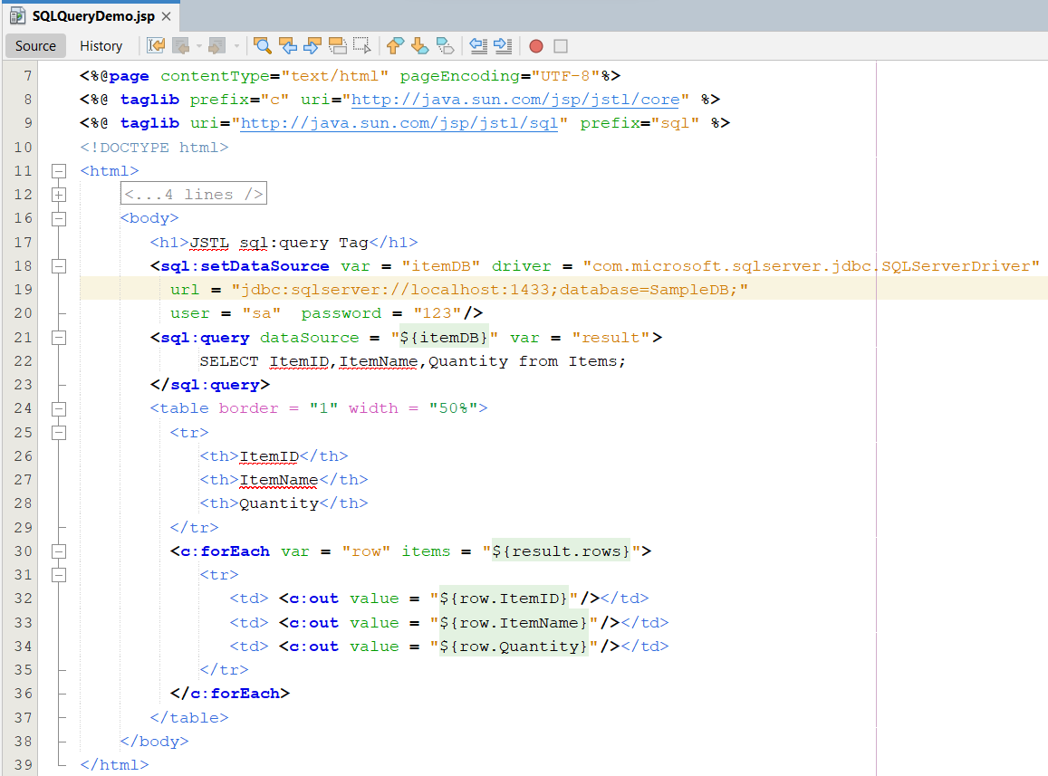
JSTL SQL Tag Library – Example

Slide 39
JSTL SQL Tag Library
SQL Tag Library
setDataSource
query
update
transaction
param

Slide 40
Summary
How to remove all java code in JSP (View)? Complete the MVC 2 Design Pattern with View
JSTL
How to build the data grid tag library using in JSP?
Tag Libraries
Model
Classical, Simple, and Handles
How to implement the custom Tag Lib and use it in JSP
Q&A

Slide 41
Next Lecture
How to preprocess in web application?
Filter
Filter Chain
Using Filter as Controller in MVC2 Design Pattern

Slide 42
Practice
Do Lab06_ManageUsersByMVC2_JSTL.pdf

Slide 43
Quize
Do Quiz 1 , pass : 1
Do Quiz 2, pass : 2

Slide 44
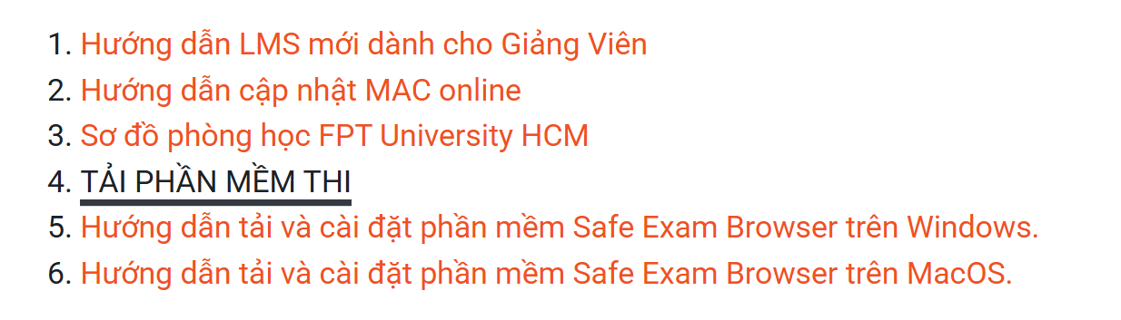
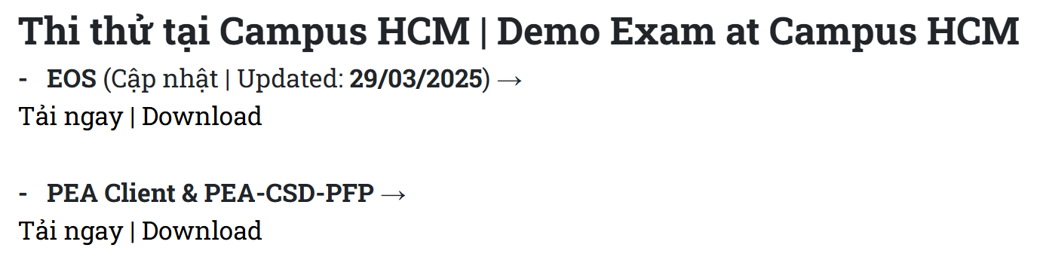
Trial Exam-PRJ301
Test Name: PE_PRJ301_TEST_135246
Đọc hướng dẫn sử dụng PEA-User Guide.pdf trên thư mục TaiLieu_PRJ301 (Google Drive)
Kết nối wifi FPTU_Exam. Mật khẩu: 12345678 (nếu chưa đăng ký MAC address thì liên hệ IT-P.102, ngược lại thì Forget network rồi kết nối lại)
Tải phần mềm thi mới nhất tại LMS: PEA_Client_Campus_THITHU
4. Nộp bài theo hướng dẫn trong phần mềm thi, trước khi nộp cần thực hiện các bước sau:
-Kiểm tra và thiết lập lại chuỗi kết nối đến database theo đề bài đã cho ban đầu (nếu có thay đổi)
-Xóa tập tin .war trong thư mục dist (nếu có), rồi copy TOÀN BỘ MÃ NGUỒN (bao gồm tất cả các tập tin và thư mục) của project vào thư mục src , copy tập tin sqljdbc.jar vào thư mục run , sau đó nộp bài. Tạo thư mục Q1 chứa 02 thư mục con run và src

Slide 45
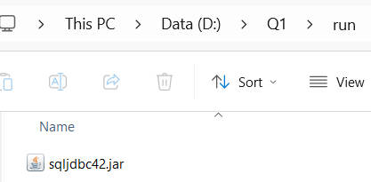




Trial Exam-PRJ301
Submit thư mục Q1 vào
PEA Client

